Slide 1
Tutorial 4
Statistical Computation and Analysis
Spring 2025

Slide 2
Tutorial Outline
Probabilistic Programming Languages
Analyzing the posterior
Arviz
KDE
HDI
Savage-Dickey Density Ratio
ROPE
PyTensor

Slide 3
Probabilistic Programming Languages
Data
Knowns
Constants
Unknowns
Parameters
Bayesian inference
Condition the unknowns on the knowns

Slide 4
Probabilistic Programming Languages
Challenge
Fully probabilistic models often lead to analytically intractable expressions
Probabilistic Programming Languages
Allow clear separation between model creation and inference
Users specify a full probabilistic model by writing a few lines of code, and then inference follows automatically

Slide 5
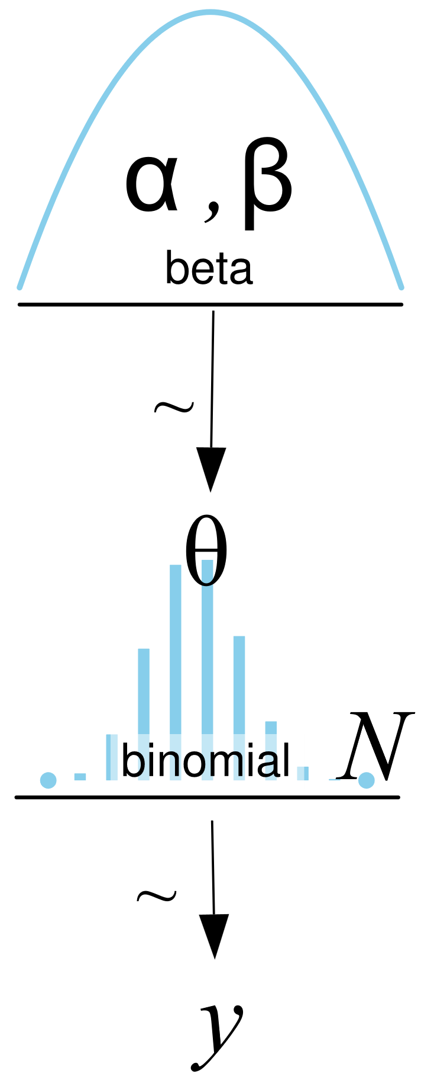
Translating a Graphical Model to a PPL
Coin flipping
Graphical model
Equations
PyMC (a PPL)
with pm.Model() as our_first_model:
θ = pm.Beta('θ', alpha=1., beta=1.)
y = pm.Bernoulli('y', p=θ, observed=data)
idata = pm.sample(1000, random_seed=4591)

Slide 6
Translating a Graphical Model to a PPL
Coin flipping
Line 1: creates a container for our model. Everything inside the with block will be automatically added to our_first_model.
Line 2: prior
Line 3: likelihood
Line 4: computes the posterior using numerical methods.
with pm.Model() as our_first_model:
θ = pm.Beta('θ', alpha=1., beta=1.)
y = pm.Bernoulli('y', p=θ, observed=data)
idata = pm.sample(1000, random_seed=4591)
Notes:
We’ll learn more about line 4 later on.

Slide 7
Translating a Graphical Model to a PPL
The use of numerical methods solves the challenge of posteriors we cannot compute.
However, what we get are samples from the posterior, rather than the posterior itself.
Every time we run the inference, the samples will change.
If the inference process works as expected, the samples will be representative of the posterior distribution, and we will obtain the same conclusion from any of those samples.

Slide 8
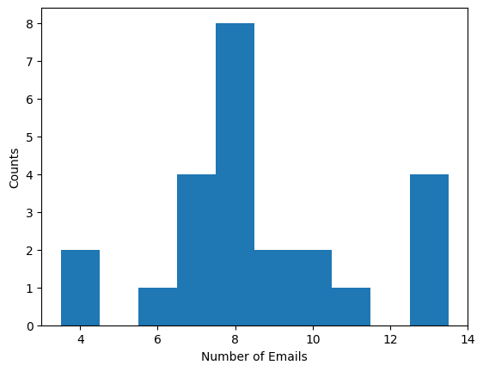

Translating a Graphical Model to a PPL
Number of emails
Poisson likelihood
Gamma prior on $λ$

Slide 9
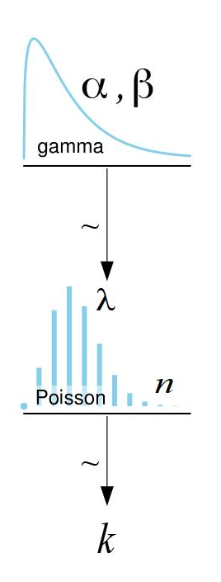
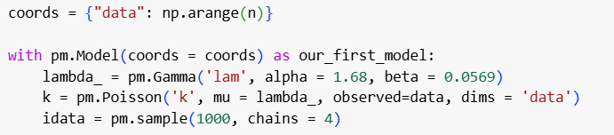
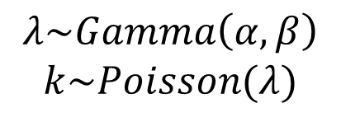
Translating a Graphical Model to a PPL
Number of emails
Graphical model
Equations
PyMC (a PPL)
$$λ\sim Gamma\left(α, β\right)$$
$$k\sim Poisson(λ)$$
Notes:
In the distributions, first parameter is the name – we choose

Slide 10
PyMC structure
Preliz
Specialized applications
PyMC
Distributions
Samplers
Models
Arviz
Utilities
Variational Bayes
Bambi
Notes:
Utilites manipulate the distributions, such as putting them together.
For very complicated models thay have the specilized applications where everything Is put together.
Two kinds of samplers. One where you sample, and the variabtional where you estimate something which is easier to sample.
Bamibi - does green and orange together for regression models.

Slide 11
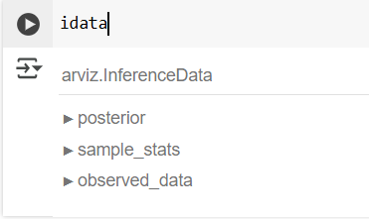
Inference Data Object
idata – what we get back from the inference process
Container for all the data generated by PyMC.
Xarray object
We will use the Arviz library to analyze the posterior
Notes:
Xarray object

Slide 12
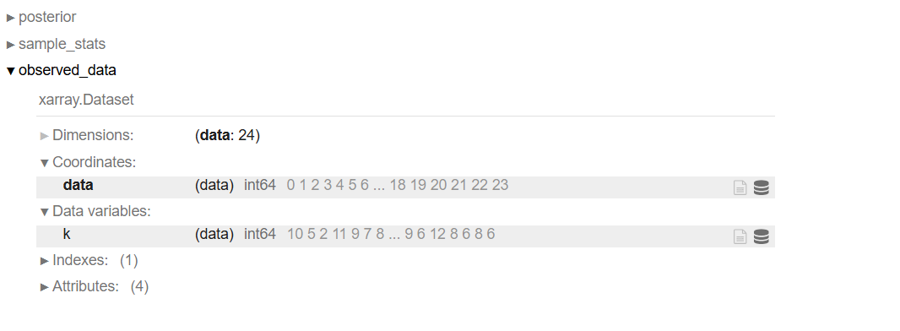
Inference Data Object
Observed data
Number of samples collected (24)
Their coordinates – here just 0-23
The values – the numbers of emails received by each student

Slide 13
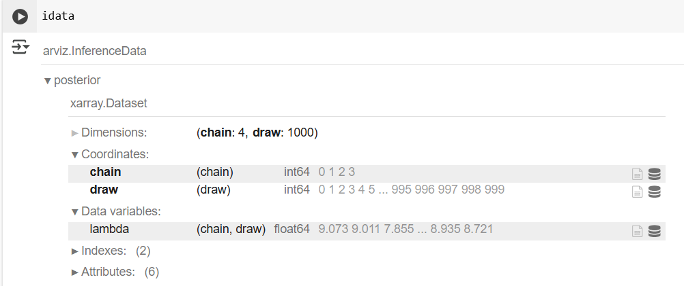
Inference Data Object
Posterior
4 chains of 1000 samples (draws) each
The lambda values (4, 1000)

Slide 14
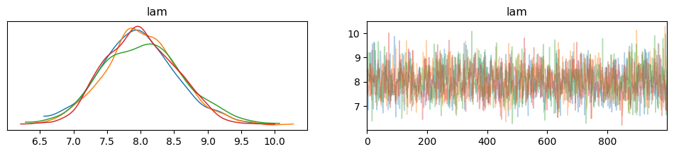
Analyzing the Posterior
Look at the results
az.plot_trace(idata)
Notes:
Every chain needs to be trained - get 1000 samples for 2000 samples that we took.
So using more than 3-4 chains is a waste.
2 - cant tell if a chain is messed up or if the sampling is.
Tradeoff between sample efficiency and how well you can evaluate how good your sampling is.
The right graph – the samples we got for each chain in the order we got them

Slide 15
Analyzing the Posterior
Left: the four chains showing the values of the posterior distribution (KDE plot = Kernel Density Estimation)
Right: For now – the overlap between the four colors shows that the sampler is working.

Slide 16
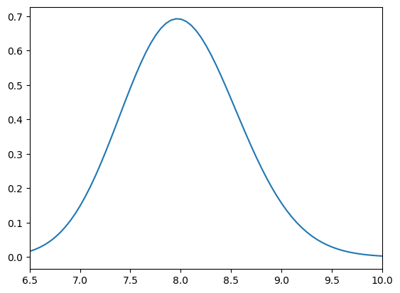
Analyzing the Posterior
Compare our analytical results (from Tutorial 3) to these:

Slide 17
Analyzing the Posterior
We want all the chains to overlap as much as possible.
How much?
We’ll learn statistics with thresholds we can calculate
For now, It looks pretty good.

Slide 18
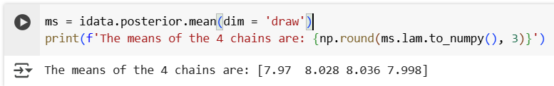
Analyzing the Posterior
How close are the means of the different chains?

Slide 19
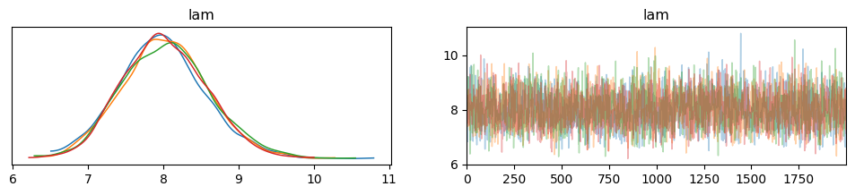
Analyzing the Posterior
How can we get the chains to look more similar?
Sample more (2000)

Slide 20
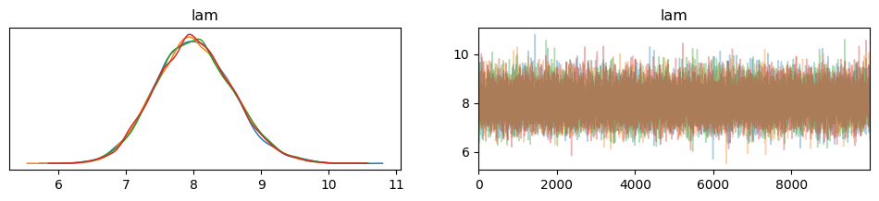
Analyzing the Posterior
How can we get the chains to look more similar?
Sample more (10,000)

Slide 21
Highest Density Interval (HDI)
We computed the mean
We can also compute other statistics, such as the HDI
The Z% HDI is the interval of values containing Z% of the probability

Slide 22
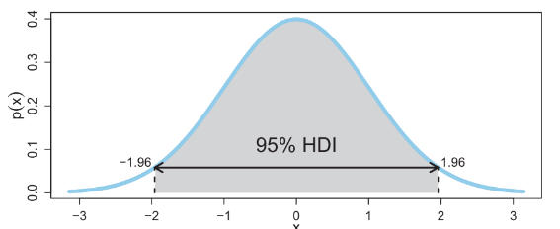
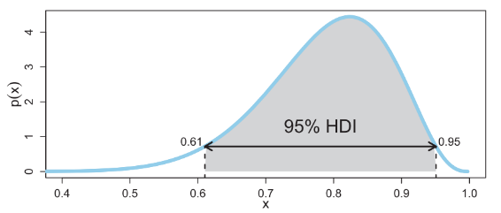
Highest Density Interval (HDI)
There are a lot of intervals like this.
The HDI is the shortest interval containing Z% of the distribution.
Equivalent: the probability of all values inside the HDI are higher than those out of it.

Slide 23
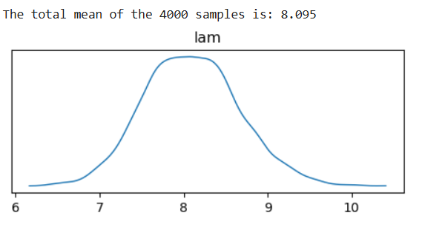
Highest Density Interval (HDI)
The default in Arviz is the 94% HDI, so that’s what we’ll generally use.
Often, the 50% HDI is also reported
Before we plot, we can in general combine the 4 chains to 4000 samples:

Slide 24
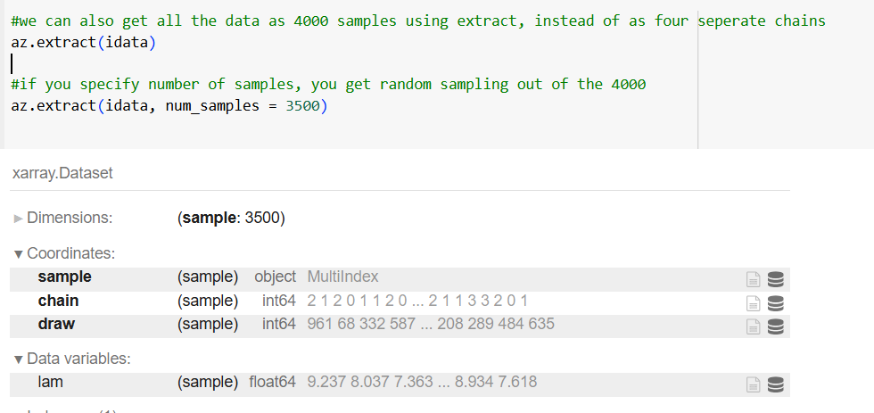
Highest Density Interval (HDI)
We can also get the data as samples instead of as separate chains using az.extract

Slide 25

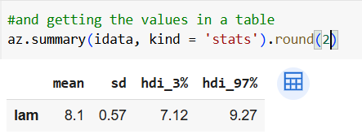
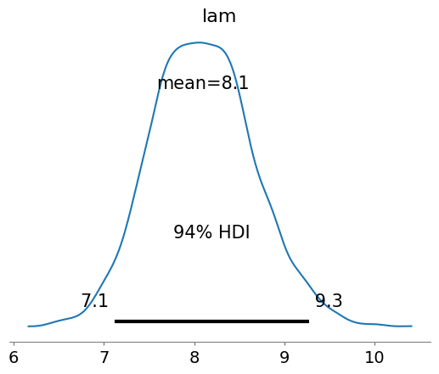
Highest Density Interval (HDI)
We can plot HDI and compute the values
Lower limit
Upper limit

Slide 26
Help Pages
Arviz: https://python.arviz.org/en/stable/api/index.html
PyMC: https://www.pymc.io/projects/docs/en/stable/api.html
Preliz: https://preliz.readthedocs.io/en/latest/index.html\
Notes:
Open arviz example with them

Slide 27
Posterior Based Decisions
Sometimes we would like to do more than describe the posterior
Sometimes we’d like to make a decision
Is the coin fair?
Is the person sick?
Do biomedical students receive 9 emails a day?
Notes:
Here there isn’t really a good question to ask, so lets make one up

Slide 28
Posterior Based Decisions
9 is inside the 94% HDI.
We can compute a value called the Savage-Dickey density ratio.

Slide 29
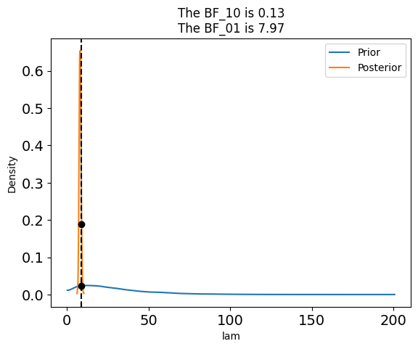
Savage-Dickey Density Ratio
The ratio of the posterior and prior densities at that value.
Evaluates how much support the posterior provides for a given value
BF_01 = 7.97
The value of 9 emails is 7.97 times
more likely under the posterior than
under the prior.
BF_10 = 1/BF_01

Slide 30
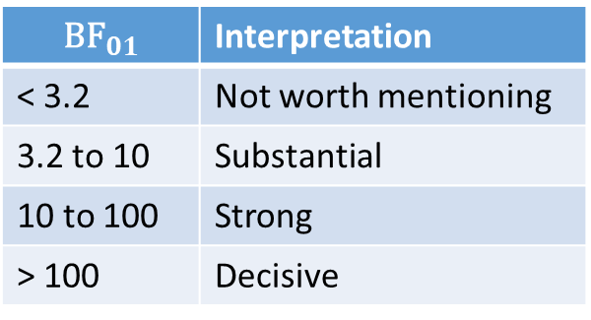
Savage-Dickey Density Ratio
How do we a decision?
Rule of thumb

Slide 31
ROPE
Region of Practical Equivalence
For example, students will not each get exactly 9 emails a day.
Let’s say we think between 8-10 is pretty much the same as 9.
ROPE is defined using domain knowledge.

Slide 32
ROPE
If the ROPE and HDI do not overlap
Students don’t receive 9 emails a day
If the ROPE contains the entire HDI
Students receive 9 emails a day
If the ROPE and HDI partially overlap
We can’t say if students do or do not receive 9 emails a day

Slide 33
ROPE
If the ROPE and HDI do not overlap
Students don’t receive 9 emails a day
If the ROPE contains the entire HDI
Students receive 9 emails a day
If the ROPE and HDI partially overlap
We can’t say if students do or do not receive 9 emails a day
If the definition of the ROPE changes our conclusions – maybe question it.

Slide 34
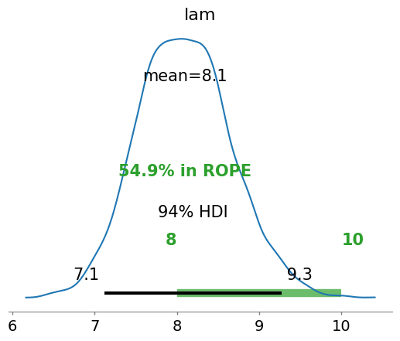
ROPE
Can we conclude if students receive 9 emails a day?
No

Slide 35
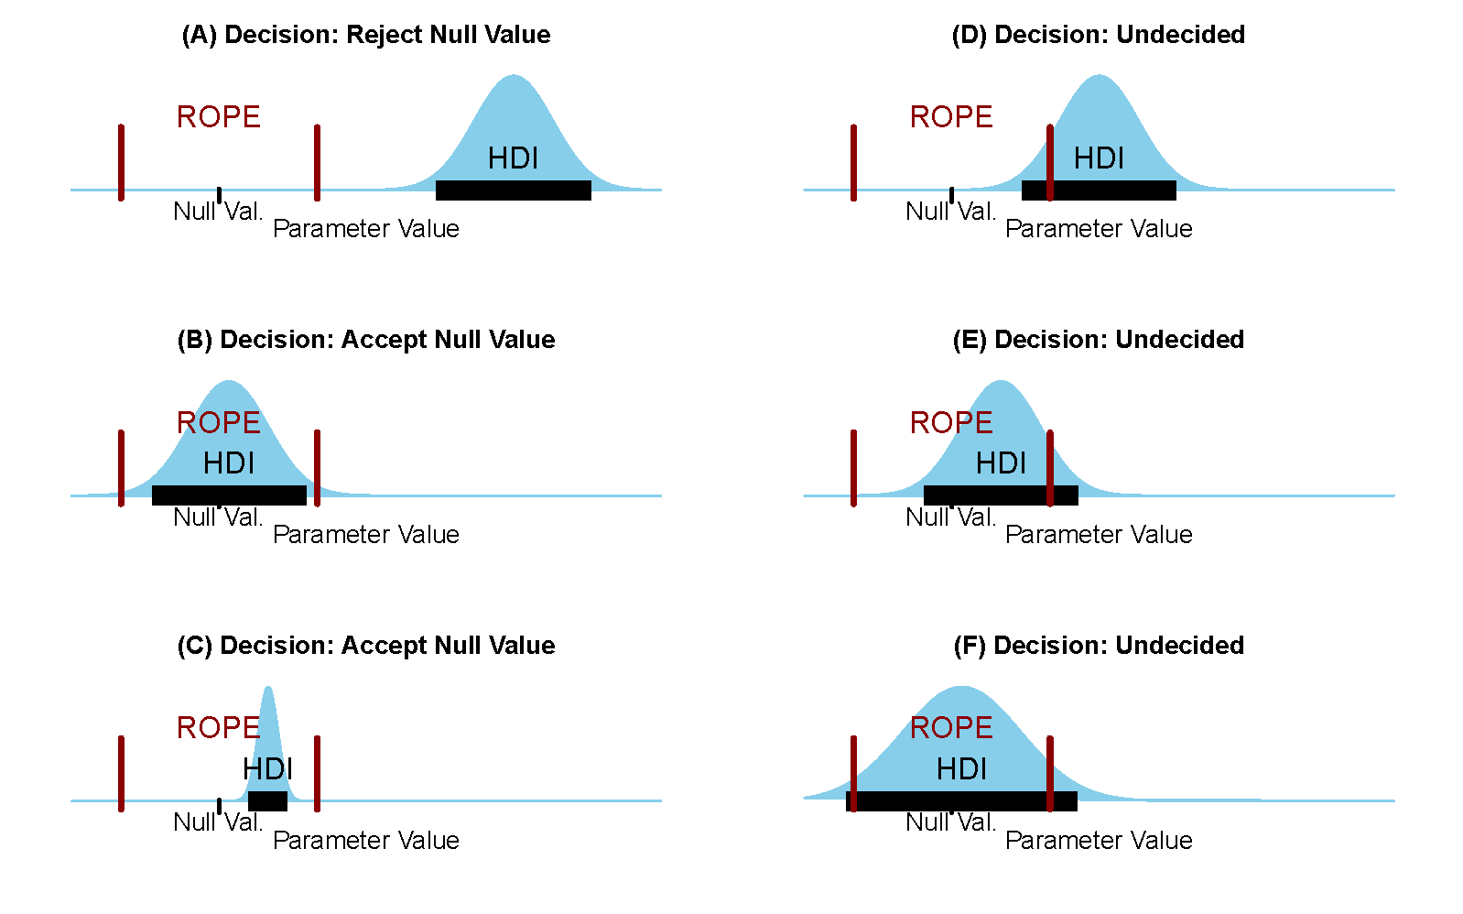
ROPE

Slide 36
PyTensor
Allows for defining, optimizing, and efficiently evaluating mathematical expressions involving multi-dimensional arrays.
A tensor is a generalized mathematical structure that can represent scalars, vectors, matrices, and higher-dimensional arrays.
Unlike other variables, tensors don’t have to have a defined shape to be manipulated.
This can be useful for cases in which tensors exist without a concrete shape until execution or have dimensions that vary per sample.
Used in deep learning.
Computational graphs enable automatic differentiation for efficient gradient computation using the chain rule.
Notes:
Pytensor.function() is alias for pytensor.compile.function.function().
Each pymc object is a pytensor object

Slide 37
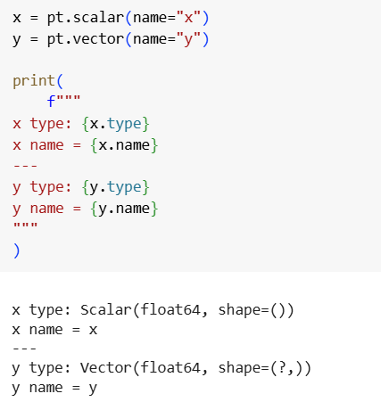
PyTensor
Define some simple tensors

Slide 38
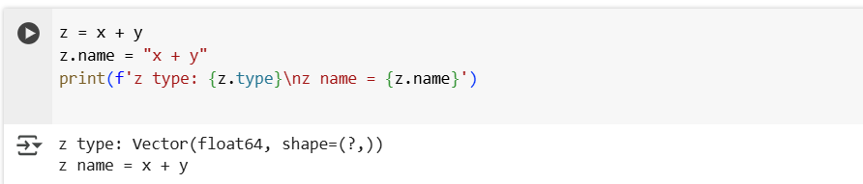

PyTensor
We can define a new tensor using our two defined tensors

Slide 39
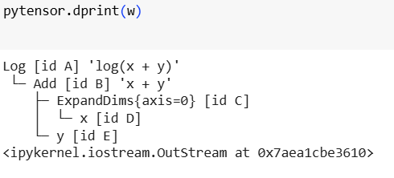
PyTensor
Let’s print the computational graph of our tensor.

